Slide 1




Noida Institute of Engineering and Technology, Greater Noida
JSP
Unit: 2
ADVANCED JAVA PROGRAMMING
ACSE0651/AMICSE0601/ACSEH0601
Faizan Ahmad
CSE AIML
Course Details B.Tech 6th Sem

Slide 2
Faculty Profile
Experience | Details
Total Experience | 9 Yrs
Teaching Experience | 7 years Subject Taught/Lab: OOT using JAVA, Advanced java programming/Lab, Artificial Intelligence and Web Technology, Computer network Subject Interest: OOTS, JAVA, Artificial intelligence
Industrial Work Experience | 2 Years
Education Background | M.Tech in CSE from Integral University, Lucknow B.Tech in CSE from AKTU, Lucknow

Slide 3
Syllabus
B. TECH. THIRD-YEAR
Course code |  | AMICSE0601 | L T P | Credits
Course title |  | ADVANCED JAVA PROGRAMMING | 3 0 0 | 3
Course objective: Objective of this course is to provide the ability to design console based, GUI based, web based applications, integrated development environment to create, debug and run multi-tier and enterprise-level applications.
Pre-requisites: Basics of C, C++, and basic concept of Core JAVA.
Course Contents / Syllabus
UNIT-I | INTRODUCTION |  |  | 8 Hours
JDBC: Introduction, JDBC Driver, DB Connectivity, Driver Manager, Connection, Statement, Result Set, Prepared Statement, Transaction Management, Stored Procedures. Servlet: Servlet Overview, Servlet API, Servlet Interface, Generic Servlet, HTTP Servlet, Servlet Life Cycle, Redirect requests to other resources, Session Tracking, Event and Listener.
UNIT-II | JSP |  |  | 8 Hours
JSP: Introduction, Overview, JSP Scriptlet Tag, JSP expression Tag, JSP declaration Tag, Life Cycle of JSP, JSP API, Implicit Objects: JSP request, JSP response, JSP config, JSP session, JSP Application, JSP Page Context; JSP Page, JSP Exception.
UNIT-III | Spring 5.0 |  |  | 8 Hours
Spring 5.0: Spring Core Introduction and Overview, Managing Beans, The Spring Container, The Factory Pattern, Dependency Injection (DI), Spring Managed Bean Lifecycle, Constructor Injection, Metadata/ Configuration: Life Cycle Annotations, Java Configuration, XML Free configuration.

Slide 4
Syllabus
UNIT-IV |  | Spring MVC & Spring Boot |  | 8 Hours
Spring MVC: Introduction/Developing Web Application with Spring MVC, Advanced Techniques, Spring Controllers Spring Boot: Spring Boot Starters, CLI, Application Class, Logging, Auto Configuration Classes, Spring Boot dependencies, Spring data JPA introduction and Overview.
UNIT-V |  | JPA |  | 8 Hours
JPA: Introduction & overview of data persistence, Overview of ORM tools, Understanding JPA, Entities: Requirement for Entity Class, Persistent Fields and Properties, Primary keys in Entries, Entity Management,Querying Entities, Entities Relationships.
Course outcome: After completion of this course students will be able to
CO 1 | Understand the concept of implementing the connection between Java and Database using JDBC. |  | K2,K4
CO 2 | Understand, Analyse, and Build dynamic web pages for server-side programming |  | K2,K3
CO 3 | Analyze and design the Spring Core Modules and DI to configure and wire beans (application objects) together |  | K4,K5
CO 4 | Design Model View Controller architecture and ready components that can be used to develop flexible and loosely coupled web applications. |  | K2,K3.K6
CO 5 | Deploy JPA to Map, store, retrieve, and update data from java objects to relational databases and vice versa. |  | K5

Slide 5
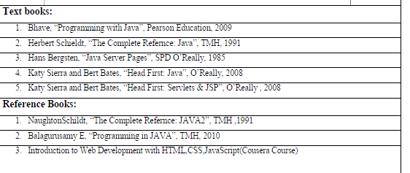
Syllabus
NPTEL/ YouTube/ Faculty Video Link:
Unit1
https://youtu.be/96xF9phMsWA
https://youtu.be/Zopo5C79m2k
Unit 2 https://youtu.be/vHmUVQKXlVo
https://youtu.be/qz0aGYrrlhU
Unit 3 https://youtu.be/GBOK1-nvdU4
https://youtu.be/YpsFT50mths?list=PLd3UqWTnYXOlc93disyBjyFv-r1Vq-5zh
Unit 4 https://youtu.be/-qfEOE4vtxE
https://youtu.be/PkZNo7MFNFg
Unit 5 https://youtu.be/_GMEqhUyyFM
https://youtu.be/ImtZ5yENzgE

Slide 6
Content
JSP: Introduction
Overview
JSP Scriptlet Tag
JSP expression Tag
JSP declaration Tag
Life Cycle of JSP
JSP API
Implicit Objects: JSP request
JSP response
JSP config
JSP session
JSP Application
JSP Page Context
JSP Page
JSP Exception

Slide 7
Branch wise Applications
Desktop GUI Applications
Mobile Applications
Artificial intelligence
Web applications
Big Data technology
Gaming applications
Business applications
Embedded systems
Cloud applications
Scientific applications

Slide 8
Course Objective
Objective of this course is to provide the ability to design console based, GUI based, web based applications, integrated development environment to create, debug and run multi-tier and enterprise-level applications.
To design and develop the dynamic web sites using, Servlet and jsp.
To understand the concept of business logic to develop the enterprises application by Spring framework.
To apply the MVC design pattern in developing a live project.
To learn the concept of database handling in java and apply this concept in transactional processing based project.

Slide 9

Course Outcomes
Course outcomes : After completion of this course students will be able to
CO 1 | Understand the concept of implementing the connection between Java and Database using JDBC. | K2,K4
CO 2 | Understand, Analyse, and Build dynamic web pages for server-side programming | K2,K2
CO 3 | Analyze and design the Spring Core Modules and DI to configure and wire beans (application objects) together | K4,K5
CO 4 | Design Model View Controller architecture and ready components that can be used to develop flexible and loosely coupled web applications. | K2,K3,K6
CO 5 | Deploy JPA to Map, store, retrieve, and update data from java objects to relational databases and vice versa. | K5

Slide 10

End Semester Question paper Templates
 |  | SECTION – A |  | CO
 | Attempt all parts- |  | [10×1=10]
 | 1-a. | Question- | (1)
 | 1-b. | Question- | (1)
 | 1-c. | Question- | (1)
 | 1-d. | Question- | (1)
 | 1-e. | Question- | (1)
 | 1-f. | Question- | (1)
 | 1-g. | Question- | (1)
 | 1-h. | Question- | (1)
 | 1-i. | Question- | (1)
 | 1-j. | Question- | (1)
2. | Attempt all parts- |  | [5×2=10] | CO
 | 2-a. | Question- | (2)
 | 2-b. | Question- | (2)
 | 2-c. | Question- | (2)
 | 2-d. | Question- | (2)
 | 2-e. | Question- | (2)

Slide 11
End Semester Question paper Templates
SECTION – B |  |  |  | CO
3. | Answer any five of the following- |  | [5×6=30]
 | 3-a. | Question- | (6)
 | 3-b. | Question- | (6)
 | 3-c. | Question- | (6)
 | 3-d. | Question- | (6)
 | 3-e. | Question- | (6)
 | 3-f. | Question- | (6)
 | 3-g. | Question- | (6)
SECTION – C |  |  |  | CO
4 | Answer any one of the following- |  | [5×10=50]
 | 4-a. | Question- | (10)
 | 4-b. | Question- | (10)
5. | Answer any one of the following-
 | 5-a. | Question- | (10)
 | 5-b. | Question- | (10)
6. | Answer any one of the following-
 | 6-a. | Question- | (10)
 | 6-b. | Question- | (10)
7. | Answer any one of the following-
 | 7-a. | Question- | (10)
 | 7-b. | Question- | (10)
8. | Answer any one of the following-
 | 8-a. | Question- | (10)
 | 8-b. | Question- | (10)

Slide 12
Prerequisite & Recap
Pre-requisites:
OOTs Concepts, Java Programming, JDBC Driver, DB Connectivity, Servlet
Recap:
JDBC: Introduction, JDBC Driver, DB Connectivity, Driver Manager, Connection, Statement, Result Set, Prepared Statement, Transaction Management, Stored Procedures.
Servlet: Servlet Overview, Servlet API, Servlet Interface, Generic Servlet, HTTP Servlet, Servlet Life Cycle, Redirect requests to other resources, Session Tracking, Event and Listener.

Slide 13
Brief Introduction about the subject with videos
Advance Java Programming provides libraries to understand the concept of Client-Server architecture for web- based applications.
We can also work with web and application servers such as Apache Tomcat and Glassfish Using these servers, we can understand the working of HTTP protocol.
It provides a set of services, API and protocols, that provides the functionality which is necessary for developing multi-tiered application, web-based application.
There is a number of advance Java frameworks like, Spring, Hibernate, Struts, that enables us to develop secure transaction-based web applications such as banking application, inventory management application.
https://youtu.be/AGGePFPiNfU?list=PLlhM4lkb2sEjVsbbZ_kiixY5CcR84IQUg https://youtu.be/96xF9phMsWA https://youtu.be/Zopo5C79m2k

Slide 14
Unit Objective
.
The objective of this unit is to provide a comprehensive understanding of Java Server Pages (JSP) technology and its core concepts, focusing on enabling learners to develop dynamic web applications efficiently

Slide 15
Topic Objective
JDBC: Introduction, JDBC Driver, DB Connectivity, Driver Manager, Connection, Statement, Result Set, Prepared Statement, Transaction Management, Stored Procedures. Servlet: Servlet Overview, Servlet API, Servlet Interface, Generic Servlet, HTTP Servlet, Servlet Life Cycle, Redirect requests to other resources, Session Tracking, Event and Listener. | It provides universal data access from the Java programming language.
JSP: Introduction, Overview, JSP Scriptlet Tag, JSP expression Tag, JSP declaration Tag, Life Cycle of JSP, JSP API, Implicit Objects: JSP request, JSP response, JSP config, JSP session, JSP Application, JSP Page Context; JSP Page, JSP Exception. | To learn creating web application.
Spring 5.0: Spring Core Introduction and Overview, Managing Beans, The Spring Container, The Factory Pattern, Dependency Injection (DI), Spring Managed Bean Lifecycle, Constructor Injection, Metadata/Configuration: Life Cycle Annotations, Java Configuration, XML Free configuration. | To understand Java framework which is used to build web applications.

Slide 16
Topic Objective
Spring MVC: Introduction/Developing Web Application with Spring MVC, Advanced Techniques, Spring Controllers Spring Boot: Spring Boot Starters, CLI, Application Class, Logging, Auto Configuration Classes, Spring Boot dependencies, Spring data JPA introduction and Overview. | To learn design pattern that separates the business logic, presentation logic and data.
JPA: Introduction & overview of data persistence, Overview of ORM tools, Understanding JPA, Entities: Requirement for Entity Class, Persistent Fields and Properties, Primary keys in Entries, Entity Management, Querying Entities, Entities Relationships. | To learn how we can examine, control, and persist data between Java objects and relational databases.

Slide 17
JSP Introduction
It stands for Java Server Pages.
It is a server side technology.
It is used for creating web application.
It is used to create dynamic web content.
In this JSP tags are used to insert JAVA code into HTML pages.
It is an advanced version of Servlet Technology.
It is a Web based technology helps us to create dynamic and platform independent web pages.
In this, Java code can be inserted in HTML/ XML pages or both.
JSP is first converted into servlet by JSP container before processing the client’s request.

Slide 18
Advantages of JSP over Servlet
Extension to Servlet
JSP technology is the extension to Servlet technology. We can use all the features of the Servlet in JSP. In addition to, we can use implicit objects, predefined tags, expression language and Custom tags in JSP, that makes JSP development easy.
Easy to maintain
JSP can be easily managed because we can easily separate our business logic with presentation logic. In Servlet technology, we mix our business logic with the presentation logic.
Fast Development: No need to recompile and redeploy
If JSP page is modified, we don't need to recompile and redeploy the project. The Servlet code needs to be updated and recompiled if we have to change the look and feel of the application.
Less code than Servlet
In JSP, we can use many tags such as action tags, JSTL, custom tags, etc. that reduces the code. Moreover, we can use EL, implicit objects, etc.

Slide 19
JSP compilation into Servlets
JSP
Initial
request
Web
Browser
Web
Server
J2EE Web
Container
translation
Java
Servlets
Subseq
request

Slide 20
More on JSP syntax and contents
HTML code for user interface lay out
JSP tags: declarations, actions, directives, expressions, scriplets
JSP implicit objects: a request object, response object, session object, config object
Javabeans: for logic that can be taken care of at the JSP level.
We will examine only JSP tags here.

Slide 21
JSP Scriptlet tag (Scripting elements)
In JSP, java code can be written inside the jsp page using the scriptlet tag. Let's see what are the scripting elements first.
JSP Scripting elements
The scripting elements provides the ability to insert java code inside the jsp.
There are three types of scripting elements:
Scriptlet tag
expression tag
declaration tag

Slide 22
JSP Tags
Declaration: variable declaration
<%! int age = 56 %>
Directive: ex: import classes
<%@ page import = “java.util.*” %>
Scriplet: Java code
<% if password(“xyz”) {
%>
<H1> Welcome <\H1>
Expression: regular expression using variables and constants
<%= param[3]+4 %>
Action: <jsp:usebean name =“cart” class=“com.sun.java.Scart”

Slide 23
JSP scriptlet tag
A scriptlet tag is used to execute java source code in JSP. Syntax is as follows:
Syntax:
<% java source code %>
How to write scriptlet
<html>
<body>
<% out.print("welcome to jsp"); %>
</body>
</html>
Explaination
Scriptlet tag start with <% tag and ends with%> tag.
Plain Java for printing the output we write System.out.println() but in case of JSP we just write out.println() and System class automatically provided by JSP web container.
In JSP there are 9 implicit objects are there out is one among them.

Slide 24
Example
In this example, we have created two files index.html and welcome.jsp. The index.html file gets the username from the user and the welcome.jsp file prints the username with the welcome message.
File: index.html
<html>
<body>
<form action="welcome.jsp">
<input type="text" name="uname">
<input type="submit" value="go"><br/>
</form>
</body>
</html>
File : welcome.jsp
<html>
<body>
<%
String name=request.getParameter("uname"); out.print("welcome "+name);
%>
</form>
</body>
</html>

Slide 25
Difference Between Declaration Tag and Scriptlet Tag
Declaration Tag | Scriptlet Tag
Declared inside <%! %> tag. | Declared inside <% %> tag.
It can declare variables as well as methods. | It can declare only variables not methods.
This tag is placed outside the _jspService() method. | This tag is placed inside the _jspService() method.
It creates only one object for multiple requests. | It creates multiple objects for multiple requests.

Slide 26
JSP expression tag
JSP Expression tags evaluates expressions. They incorporate arithmetic and logical expressions so that they can be evaluated. They form an easy means to access the value of a Java variable. The Expressions in JSP can be an access point for other expressions and merge that value in an HTML file. They can easily access data stored in applications.
Syntax of JSP expression tag
<%= expression %>
Eg :
<html>
<head>
<meta http-equiv="Content-Type" content="text/html; charset=ISO-8859-1">
<title>JSPforjava</title>
</head>
<body>
<% out.println("Hello JSP "); %> <!-- Sriptlet Tag-->
<% int n1=10; int n2=30; %><!-- Sriptlet Tag-->
<% out.println("<br>sum of n1 and n2 is "); %> <!-- Sriptlet Tag-->
<%= n1+n2 %> <!-- Expression tag -->
</body>
</html>
Output:
Hello JSP
Sum of n1 and n2 is 40

Slide 27
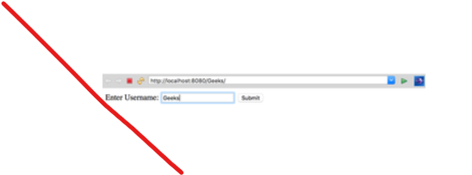
Creating an HTML file to take the username from user.save this file as index.html
<!--index.html -->
<!-- Example of JSP code which prints the Username -->
<html>
<body>
<form action=“hello.jsp">
<!-- move the control to hello.jsp when Submit button is click -->
Enter Username:
<input type="text" name="username">
<input type="submit" value="Submit"><br/>
</form>
</body>
</html>

Slide 28
JSP declaration Tag
The JSP declaration tag is used to declare fields and methods.
The code written inside the jsp declaration tag is placed outside the service() method of auto generated servlet.
syntax of the declaration tag is as follows:
<html>
<head>
<meta http-equiv="Content-Type" content="text/html; charset=ISO-8859-1">
<title>JSPforJava</title>
</head>
<body>
<!--declaration of username variable.... -->
<%! String username=“Hello"; %>
<!--In expression tag a string is initialised as Hello -->
<%="Hello : "+username %>
<!-- Displaying expression using Expression Tag -->
</body>
</html>
<%! field or method declaration %>

Slide 29
Example
<html>
<head>
<meta http-equiv="Content-Type" content="text/html; charset=ISO-8859-1">
<title>JSPforjava</title>
</head>
<body>
<html>
<body>
<%!
int factorial(int n)
{
if (n == 0)
return 1;
return n*factorial(n-1);
}
%>
<%= "Factorial of 5 is:"+factorial(5) %>
</body>
</html>
</body>
</html>
OutPut:
Factorial of 5 is 20

Slide 30
Difference between the JSP Expression, Declarative, and Scriptlet tags
Expression tag: This tag contains a scripting language expression that is converted to a String and inserted where the expression appears in the JSP file. Because the value of an expression is converted to a String, you can use an expression within text in a JSP file. You cannot use a semicolon to end an expression.
Declaration tag: This declares one or more variables or methods for use later in the JSP source file. It must contain at least one complete statement. You can declare any number of variables or methods within one declaration tag, but you have to separate them by semicolons. The declaration must be valid in the scripting language used in the JSP file.You can add method to the declaration part.
Scriptlet tag: You can declare variables in the script-let and can do any processing. All the Scriptlet go to the inside service() method of the convert servlet.

Slide 31
Practice Exercise
1.Assume four users user1, user2, user3 and user4 having the passwords pwd1, pwd2, pwd3 and pwd4 respectively. Write a servlet for doing the following. Create a Cookie and add these four-user id’s and passwords to this Cookie. 2. Read the user id and passwords entered in the Login form and authenticate with the values available in the cookies.
2. Write a JSP program to Print current date & time.
3. Write a JSP program for basic arithmetic functions.
4. Write a JSP program to display Strings.

Slide 32
Practice Exercise
5. Write a JSP program to show and display at least 3 active control.
6. Write a JSP program to upload file into server.

Slide 33
Daily Quiz
Which page directive should be used in JSP to generate a PDF page? a) contentType b) generatePdf c) typePDF d) contentPDF
Which tag should be used to pass information from JSP to included JSP? a) Using <%jsp:page> tag b) Using <%jsp:param> tag c) Using <%jsp:import> tag d) Using <%jsp:useBean> tag
Application is instance of which class? a) javax.servlet.Application b) javax.servlet.HttpContext c) javax.servlet.Context d) javax.servlet.ServletContext

Slide 34
Weekly Assignment
Create a JSP page to demonstrate how HTML and Java code can be combined to generate dynamic content.
Develop a JSP program to display the name of the server and the port number using an expression tag.
Develop a JSP page to connect to a database using a scriptlet and fetch data from a table.
Develop a JSP page to connect to a database using a scriptlet and fetch data from a table.
Write a JSP program that uses an expression tag to display the square of a given number.
Create a JSP page that uses a declaration tag to declare a global variable and demonstrates its use across different requests.

Slide 35
JSP API
JSP API is a set of classes and interfaces that can be used to make a JSP page. These classes and interfaces are contained in the javax servlet.jsp packages. A portion of the classes characterized in the javax. servlet.jsp packages are:
Error Data
JSP Writer
Page Context
The Error Data Class: The error information class characterizes error data for error pages. You have to set the estimation of the page mandate, isErrorPage to be consistent with demonstrating that a page is an error page. The error information class expands the java.lang.Object class. A portion of the strategies characterized in the ErrorData that you can use in a JSP page is: .

Slide 36
JSP API
getRequestURL(): Returns the mentioned URL through String.
getServletName(): Returns the name of the servlet conjured through String.
getStatusCode(): Returns the status code of the blunder as a whole number.
getThrowable(): Returns the Throwable special case that caused the mistake.

Slide 37
JSP API Cont…
The JspWriter Class: In a JSP page to compose activity and layout information we can utilize JSPWriter class. The understood variable out gives the JSPWriter class object. The JSPWriter class broadens the java.io.Writer class. A portion of the techniques characterize in the JSPWriter class that you can use in a JSP page are:
clear(): Clears the substance of the cradle. The reasonable() technique tosses an IOException special case if the support is now cleared.
close(): Closes and flushes the stream.
flush(): Flushes the cradle stream. The flush() strategy flushes every one of the cradles in a chain of Writers and OutputStream. It tosses java.io.IOException special case on the off chance that you make a call to the compose() or flush() in the wake of shutting the stream.
getBufferSize(): Return the size of the support utilized by the JSPWriter.

Slide 38
JSP API Cont…
4. print(): Prints the estimation of sort boolean, integer, character, long whole number, coasting point, twofold exactness gliding – point number, a variety of character, string, and item. The print() tosses the java.io.IOException exemption if any blunder happens while printing.
5. println(): Prints an estimation of sort boolean, whole number, character, long whole number, drifting point, twofold exactness coasting point number, a variety of character, string, and article. The Println() tosses the java.io.IOException exemption if any blunder happens while printing.

Slide 39
JSP API Cont…
The PageContext Class: The setting data is given by the PageContext class when the JSP innovation is utilized in the servlet condition. The PageContext class expands the JSPContext class. A PageContext occasion furnishes access to namespaces related to the JSP page. Some of the strategies characterized in the PageContext class are:
forward(): Redirects the current servlet demand and servlet reaction to another page. This strategy acknowledges the URL of an objective page as a contention.
getPage(): Returns the present estimation of the page object.
getRequest(): Returns the present estimation of the solicitation object. The servlet solicitation is the arrival kind of getRequest().
getResponse(): Returns the present estimation of the reaction object. The return kind of the getResponse() technique is the servlet reaction.
getServletConfig(): Returns the ServletConfig of the present page.

Slide 40
JSP API Cont…
6. getServletContext(): Returns the ServletContext of the present page.
7. getSession(): The arrival kind of getSession() is HttpSession. It will restore the current PageContext.
8. include(): Processes the current servlet demand and the reaction determined in the URL. The incorporate() technique accepts two contentions, a URL way and the flush estimation of boolean sort.

Slide 41
Session Tracking in JSP
Cookies: A little message field put away on the customers machine. The treat can be impair in the program settings so they are not constantly accessible.
URL revamping: Store session data in the URL. Works, when treats are not bolstered yet, can make bookmarking of site pages an issue since they have session explicit data toward the finish of a URL.
Avoided fields: HTML covered up alter boxes, for example:
<input type = "hidden">
Session objects: JSP Implicit Object. A session article utilizes a key/esteem mix to store information. To retrieve data from a session:
session.getValued("msg")
The arrival kind of the strategy getValue is Object, so you should typecase to get the required worth. Invalid is returned when there is no such key with the session name.

Slide 42
Implicit Objects: JSP request
The JSP request is an implicit object of type HttpServletRequest i.e. created for each jsp request by the web container. It can be used to get request information such as parameter, header information, remote address, server name, server port, content type, character encoding etc.
It can also be used to set, get and remove attributes from the jsp request scope.
Let's see the simple example of request implicit object where we are printing the name of the user with welcome message.
Example of JSP request implicit object
Index.html
<form action="welcome.jsp">
<input type="text" name="uname">
<input type="submit" value="go"><br/>
</form>

Slide 43
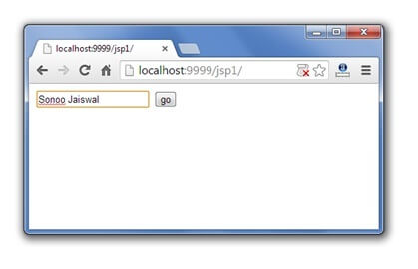
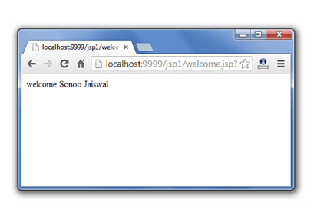
Example of JSP request implicit object Cont…
welcome.jsp
<%
String name=request.getParameter("uname");
out.print("welcome "+name);
%>

Slide 44
JSP response implicit object
In JSP, response is an implicit object of type HttpServletResponse. The instance of HttpServletResponse is created by the web container for each jsp request.
It can be used to add or manipulate response such as redirect response to another resource, send error etc.
Let's see the example of response implicit object where we are redirecting the response to the Google.

Slide 45
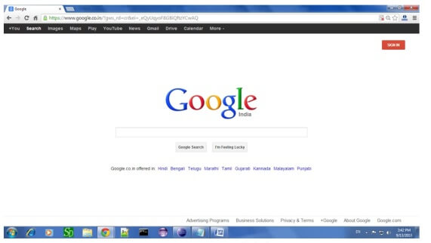
Example of response implicit object
index.html
<form action="welcome.jsp">
<input type="text" name="uname">
<input type="submit" value="go"><br/>
</form>
welcome.jsp
<%
response.sendRedirect("http://www.google.com");
%>

Slide 46
JSP Config Implicit Object
In JSP, config is an implicit object of type ServletConfig. This object can be used to get initialization parameter for a particular JSP page. The config object is created by the web container for each jsp page. SP’s config object carries the configuration pieces of information like the username, password, driver name, servlet name, servlet context, specification names, and their values settle in the web.xml (configuration file).
Generally, it is used to get initialization parameter from the web.xml file.
Example of config implicit object
index.html
<form action="welcome">
<input type="text" name="uname">
<input type="submit" value="go"><br/>
</form>

Slide 47
Example of config implicit object Cont…
web.xml file
<web-app>
<servlet>
<servlet-name>sonoojaiswal</servlet-name>
<jsp-file>/welcome.jsp</jsp-file>
<init-param>
<param-name>dname</param-name>
<param-value>sun.jdbc.odbc.JdbcOdbcDriver</param-value>
</init-param>
</servlet>
<servlet-mapping>
<servlet-name>sonoojaiswal</servlet-name>
<url-pattern>/welcome</url-pattern>
</servlet-mapping>
</web-app>
welcome.jsp
<%
out.print("Welcome "+request.getParameter("uname"));
String driver=config.getInitParameter("dname");
out.print("driver name is="+driver);
%>

Slide 48
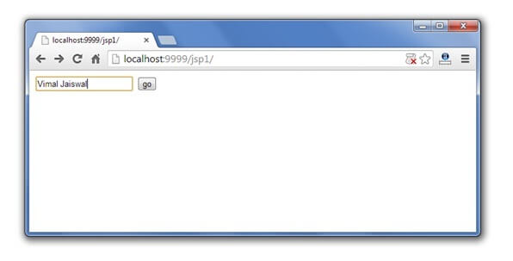
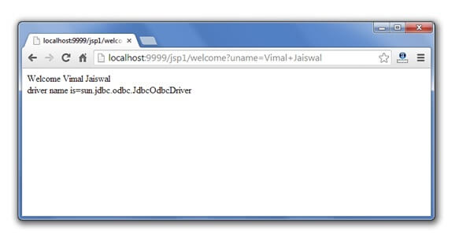
JSP COnfig implicit object Output

Slide 49
JSP Session
In JSP, session is an implicit object of type HttpSession.The Java developer can use this object to set,get or remove attribute or to get session information. It is mainly used to approach all data of the user until the user session is active
Example of session implicit object
index.html
<html>
<body>
<form action="welcome.jsp">
<input type="text" name="uname">
<input type="submit" value="go"><br/>
</form>
</body>
</html>

Slide 50
Example of session implicit object
welcome.jsp
<html>
<body>
<%
String name=request.getParameter("uname");
out.print("Welcome "+name);
session.setAttribute("user",name);
<a href="second.jsp">second jsp page</a>
%>
</body>
</html>
second.jsp
<html>
<body>
<%
String name=(String)session.getAttribute("user");
out.print("Hello "+name);
%>
</body>
</html>

Slide 51
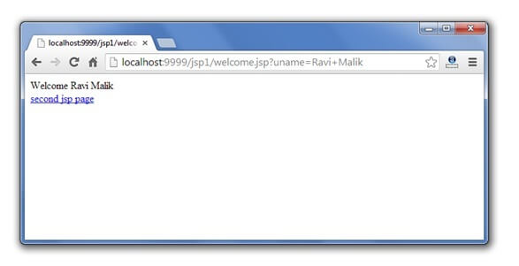
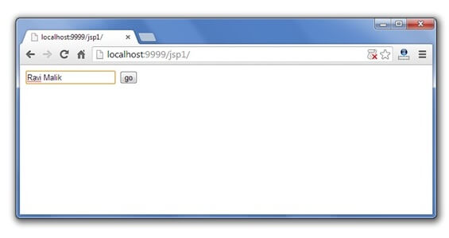
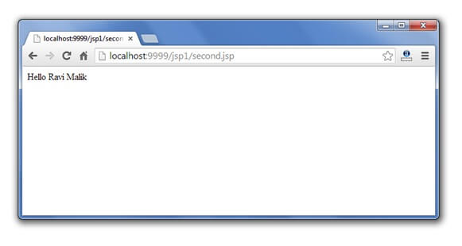
Session Implicit Object Output

Slide 52
JSP Application
In JSP, application is an implicit object of type ServletContext.
The instance of ServletContext is created only once by the web container when application or project is deployed on the server.
This object can be used to get initialization parameter from configuaration file (web.xml). It can also be used to get, set or remove attribute from the application scope.
This initialization parameter can be used by all jsp pages.

Slide 53
Example of application implicit object
web.xml file
<web-app>
<servlet>
<servlet-name>sonoojaiswal</servlet-name>
<jsp-file>/welcome.jsp</jsp-file>
</servlet>
<servlet-mapping>
<servlet-name>sonoojaiswal</servlet-name>
<url-pattern>/welcome</url-pattern>
</servlet-mapping>
<context-param>
<param-name>dname</param-name>
<param-value>sun.jdbc.odbc.JdbcOdbcDriver</param-value>
</context-param>
</web-app>
index.html
<form action="welcome">
<input type="text" name="uname">
<input type="submit" value="go"><br/>
</form>

Slide 54
Example of application implicit object Cont…
welcome.jsp
<%
out.print("Welcome "+request.getParameter("uname"));
String driver=application.getInitParameter("dname");
out.print("driver name is="+driver);
%>

Slide 55
Output of application implicit object Cont…

Slide 56
Daily Quiz
_jspService() method of HttpJspPage class should not be overridden. a) True b) False
Which option is true about session scope? a) Objects are accessible only from the page in which they are created b) Objects are accessible only from the pages which are in same session c) Objects are accessible only from the pages which are processing the same request d) Objects are accessible only from the pages which reside in same application
Which one is the correct order of phases in JSP life cycle? a) Initialization, Cleanup, Compilation, Execution b) Initialization, Compilation, Cleanup, Execution c) Compilation, Initialization, Execution, Cleanup d) Cleanup, Compilation, Initialization, Execution

Slide 57
Daily Quiz
4. What is the correct signature of jspInit() method of HttpJspPage class?
A - void jspInit(HTTPRequest request, HTTPResponse response)
B - void jspInit(HTTPRequest request, HTTPResponse response) throws ServletException, IOException
C - void jspInit()
D - void jspInit() throws ServletException, IOException
5. Which of the following is a server side technology?
A - html
B - jsp
C - javaScript
D - css
6. Which is the methods of generated Servlet?
A - jspInit()
B - _jspService()
C - jspDestroy()
D - All of the above

Slide 58
Daily Quiz
7. Which of the following attribute is used to mark a page as error processing page?
A - isErrorPage
B - errorPage
C - exception
D - exceptionPage
8. Which of the following method can be used to read parameters names?
A - request.getParameter()
B - response.getParameter()
C - request.getParameterNames()
D - response.getParameterNames()
9. Is it possible to include files using absolute path in a JSP page using include directive?
A - true
B - false

Slide 59
Page Context implicit object
JSP, page Context is an implicit object of type Page Context class. The page Context object can be used to set,get or remove attribute from one of the following scopes: page request session application
In JSP, page scope is the default scope.

Slide 60
Example of page Context implicit object
second.jsp
<html>
<body>
<%
String name=(String)pageContext.getAttribute("user",PageContext.SESSION_SCOPE);
out.print("Hello "+name);
%>
</body>
</html>
index.html
<html>
<body>
<form action="welcome.jsp">
<input type="text" name="uname">
<input type="submit" value="go"><br/>
</form>
</body>
</html>
welcome.jsp
<html>
<body>
<%
String name=request.getParameter("uname");
out.print("Welcome "+name);
pageContext.setAttribute("user",name,PageContext.SESSION_SCOPE);
<a href="second.jsp">second jsp page</a>
%>
</body>
</html>

Slide 61
Output of page Context implicit object

Slide 62
JSP Page
A JSP page is a text document that contains two types of text: static data, which can be expressed in any text-based format (such as HTML, SVG, WML, and XML), and JSP elements, which construct dynamic content.
The recommended file extension for the source file of a JSP page is .jsp. The page can be composed of a top file that includes other files that contain either a complete JSP page or a fragment of a JSP page. The recommended extension for the source file of a fragment of a JSP page is .jspf.
The JSP elements in a JSP page can be expressed in two syntaxes, standard and XML, though any given file can use only one syntax. A JSP page in XML syntax is an XML document and can be manipulated by tools and APIs for XML documents.

Slide 63
Creating a simple JSP Page
To create the first JSP page, write some HTML code as given below, and save it by .jsp extension. We have saved this file as index.jsp. Put it in a folder and paste the folder in the web-apps directory in apache tomcat to run the JSP page.
index.jsp
Let's see the simple example of JSP where we are using the scriptlet tag to put Java code in the JSP page. We will learn scriptlet tag later.
<html>
<body>
<% out.print(2*5); %>
</body>
</html>
It will print 10 on the browser.

Slide 64
JSP Exception
Exceptions in JSP occur when there is an error in the code either by the developer or internal error from the system. Exception handling in JSP is the same as in Java where we manage exceptions using Try Catch blocks. Unlike Java, there are exceptions in JSP also when there is no error in the code.
Types of Exceptions in JSP
Exceptions in JSP are of three types:
Checked Exception
Runtime Exception
Error Exception

Slide 65
JSP Exception
index.jsp
<form action="process.jsp">
No1:<input type="text" name="n1" /><br/><br/>
No1:<input type="text" name="n2" /><br/><br/>
<input type="submit" value="divide"/>
</form>
process.jsp
<%@ page errorPage="error.jsp" %>
<%
String num1=request.getParameter("n1");
String num2=request.getParameter("n2");
int a=Integer.parseInt(num1);
int b=Integer.parseInt(num2);
int c=a/b;
out.print("division of numbers is: "+c);
%>

Slide 66
JSP Exception
error.jsp
<%@ page isErrorPage="true" %>
<h3>Sorry an exception occured!</h3>
Exception is: <%= exception %>

Slide 67
Checked Exceptions
It is normally a user error or problems which are not seen by the developer are termed as checked exceptions.
Some Checked exception examples are:
FileNotFoundException: This is a checked exception (where it tries to find a file when the file is not found on the disk).
IO Exception: This is also checked exception if there is any exception occurred during reading or writing of a file then the IO exception is raised.
SQLException: This is also a checked exception when the file is connected with SQL database, and there is issue with the connectivity of the SQL database then SQLException is raised

Slide 68
Runtime Exceptions
Runtime exceptions are the one which could have avoided by the programmer. They are ignored at the time of compilation.
Some Runtime exception examples are:
ArrayIndexOutOfBoundsException: This is a runtime exception when array size exceeds the elements.
ArithmeticException: This is also a runtime exception when there are any mathematical operations, which are not permitted under normal conditions, for example, dividing a number by 0 will give an exception.
NullPointer Exception: This is also a runtime exception which is raised when a variable or an object is null when we try to access the same. This is a very common exception.

Slide 69
Errors
The problem arises due to the control of the user or programmer. If stack overflows, then error can occur.
Some examples of the error are listed below:
Error: This error is a subclass of throwable which indicates serious problems that an application cannot catch.
Instantiation Error: This error occurs when we try to instantiate an object, and it fails to do that.
Internal Error: This error occurs when there is an error occurred from JVM i.e. Java Virtual Machine.

Slide 70
Error Exceptions
It is an instance of the throwable class, and it is used in error pages.
Some methods of throwable class are:
Public String getMessage() – returns the message of the exception.
Public throwablegetCause() – returns cause of the exception
Public printStackTrace()– returns the stacktrace of the exception.

Slide 71
Daily Quiz
_jspService() method of HttpJspPage class should not be overridden. a) True b) False
Which option is true about session scope? a) Objects are accessible only from the page in which they are created b) Objects are accessible only from the pages which are in same session c) Objects are accessible only from the pages which are processing the same request d) Objects are accessible only from the pages which reside in same application
Which one is the correct order of phases in JSP life cycle? a) Initialization, Cleanup, Compilation, Execution b) Initialization, Compilation, Cleanup, Execution c) Compilation, Initialization, Execution, Cleanup d) Cleanup, Compilation, Initialization, Execution

Slide 72
Weekly Assignment
How can the application object help manage shared resources in JSP?
Write a program to use request, response, and session implicit objects in a JSP page.
What is the <error-page> element in web.xml, and how does it handle JSP exceptions?
Write a JSP program to redirect users to another page using the response object.
Demonstrate how to include another JSP page using <jsp:include>.
Write a program to retrieve servlet and request attributes using pageContext.
Illustrate JSP response.
Write a program using the JSP API to dynamically generate a table based on user input.
Write a program to differentiate the scope (page, request, session, and application) of attributes in JSP.
Write a JSP program to create a global counter using the application object.
Write a program to demonstrate secure data transmission using HTTPS in JSP

Slide 73
Faculty Video Links, Youtube & NPTEL Video Links and Online Courses Details
Youtube/other Video Links
https://youtu.be/BsDoLVMnmZs
https://youtu.be/a8W952NBZUE
https://www.youtube.com/watch?v=J_d1fJy90GY&t=4s

Slide 74
Quiz
1. What does JSP stand for?
A. JavaScript Programming B. Java Server Pages C. Java Servlet Protocol D. Java Source Pages
Answer: B. Java Server Pages
2. What is the primary purpose of JSP?
A. To handle backend database operations B. To create dynamic web pages C. To replace HTML in web development D. To implement client-side scripting
Answer: B. To create dynamic web pages
3. Which of the following is NOT a valid JSP implicit object?
A. request B. response C. connection D. session
Answer: C. connection

Slide 75
Quiz
4. What is the file extension for a JSP file?
.java
.jsp
.html
.jhtml
Answer: B. .jsp
5. What is the correct syntax for a JSP expression?
<% expression %>
<%# expression %>
<%= expression %>
<%! expression %>
Answer: C. <%= expression %>
6. Which of the following is used to declare a method in JSP?
<% method declaration %>
<%! method declaration %>
<%= method declaration %>
<%@ method declaration %>
Answer: B. <%! method declaration %>

Slide 76
Quiz
7. What happens when a JSP page is requested for the first time?
A. It is directly executed without any processing. B. It is compiled into a servlet and then executed. C. It generates an HTML file for execution. D. It is compiled into a JavaScript file and executed.
Answer: B. It is compiled into a servlet and then executed.
8. Which of the following JSP lifecycle methods is invoked only once?
_jspService()
B. jspDestroy()
C. jspInit()
D. Both B and C
Answer: D. Both B and C
9. Which JSP directive is used to include another file in the JSP file at translation time?
<%@ include file="fileName" %>
B. <jsp:include page="fileName" />
C. <jsp:forward page="fileName" />
D. <%@ forward file="fileName" %>
Answer: A. <%@ include file="fileName" %>

Slide 77
Quiz
10. Which tag is used in JSP to include reusable components dynamically at runtime?
<%@ include %>
<jsp:include />
<jsp:forward />
<jsp:useBean />
Answer: B. <jsp:include />
11. Which of these is NOT a valid JSP directive?
<%@ page %>
<%@ taglib %>
<%@ session %>
<%@ include %>
Answer: C. <%@ session %>

Slide 78
Expected Questions for University Exam
Explain JSP and its elements?
Where is scriptlet tag used in JSP?
How to write the JSP expression?
Explain JSP declaration Tag with example.
Explain the phases available in JSP life cycle?
What is JSP API and how portion of the classes characterized in the javax. servlet.jsp packages?
What are the 9 implicit objects?
How to use request and response in JSP?
Explain JSP config.
How to maintain session in JSP?
What are the applications of JSP?
What is difference between page and PageContext in JSP?
What happens if an exception is thrown from a JSP?

Slide 79
Summary
JavaServer Pages (JSP) is a technology for developing Webpages that supports dynamic content. This helps developers insert java code in HTML pages by making use of special JSP tags, most of which start with <% and end with %>.
A scriptlet tag is used to execute java source code in JSP.
Expression tag is one of the scripting elements in JSP. Expression Tag in JSP is used for writing your content on the client-side.
Declaration tag is used to declare one or more variables or methods at class level.
A Java Server Page life cycle is defined as the process that started with its creation which later translated to a servlet and afterward servlet lifecycle comes into play. This is how the process goes on until its destruction.
JSP API is a set of classes and interfaces that can be used to make a JSP page.
Implicit objects are a set of Java objects that the JSP Container makes available to developers in each page.
The JSP request can be defined as an implicit object is an instance of "HttpServletRequest" and is formed for all JSP requests through the web container.

Slide 80
Summary Cont…
In JSP, response is an implicit object of type HttpServletResponse.
JSP Config is an implicit object which is used to transmit the configuration details to the JSP page.
In JSP, the session is the most regularly used implicit object of type HttpSession.
In JSP, application is an implicit object of type ServletContext. This is an instance of javax.servlet.ServletContext.
A PageContext instance is obtained by a JSP implementation class by calling the JspFactory.getPageContext() method, and is released by calling JspFactory.
A JSP page is a text document that contains two types of text: static data, which can be expressed in any text-based format (such as HTML, SVG, WML, and XML), and JSP elements, which construct dynamic content.
Exceptions in JSP occur when there is an error in the code either by the developer or internal error from the system.

Slide 81
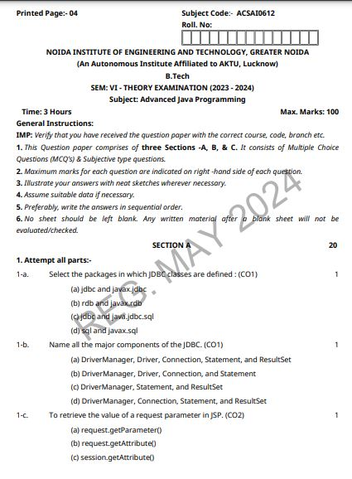
Previous Year Question Paper

Slide 82
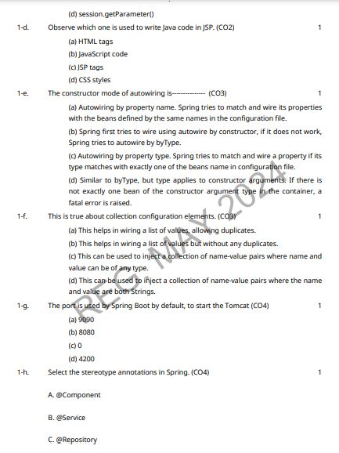
Previous Year Question Paper

Slide 83
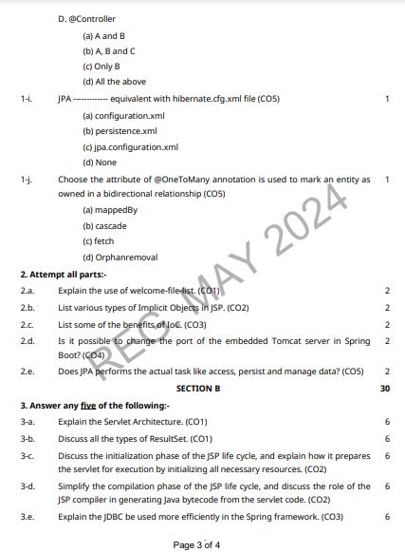
Previous Year Question Paper

Slide 84
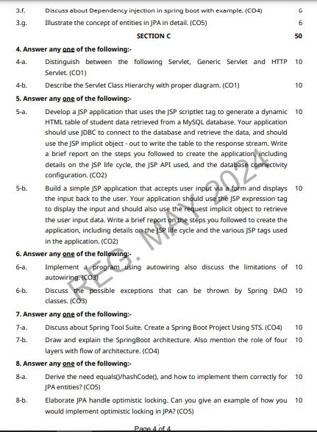
Previous Year Question Paper

Slide 85
References
Bhave, “Programming with Java”, Pearson Education, 2009
Herbert Schieldt, “The Complete Refernce: Java”, TMH, 1991
Hans Bergsten, “Java Server Pages”, SPD O’Really, 1985
Katy Sierra and Bert Bates, “Head First: Java”, O’Really, 2008
Katy Sierra and Bert Bates, “Head First: Servlets & JSP”, O’Really , 2008
NaughtonSchildt, “The Complete Refernce: JAVA2”, TMH ,1991
Balagurusamy E, “Programming in JAVA”, TMH, 2010
Introduction to Web Development with HTML,CSS,JavaScript(Cousera Course)

Slide 86
Thank You

